Slide 1
모델, 애니메이션 에셋 제안
3학년 산학 프로젝트
(유니티 에셋스토어)

Slide 2
목차
1. 캐릭터 모델 / 애니메이션
2. 미니언 모델 / 애니메이션
3. 맵 모델
4. 프로토타입

Slide 3
1. 캐릭터 모델 / 애니메이션

Slide 4
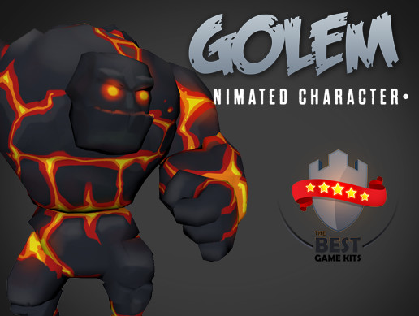
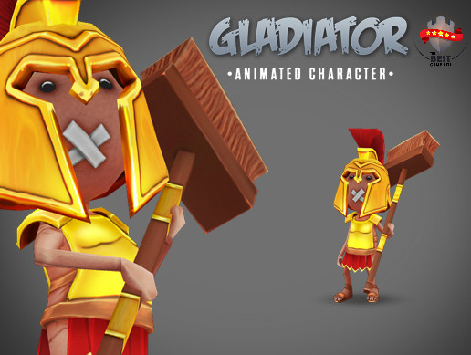
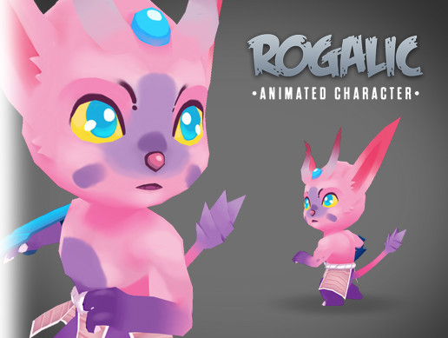
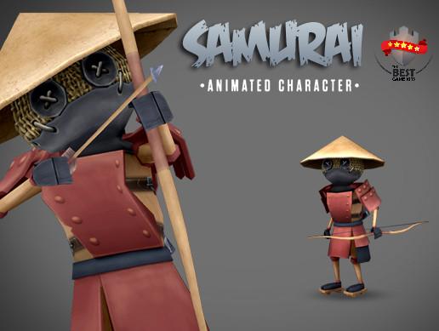
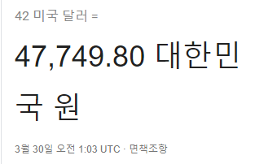
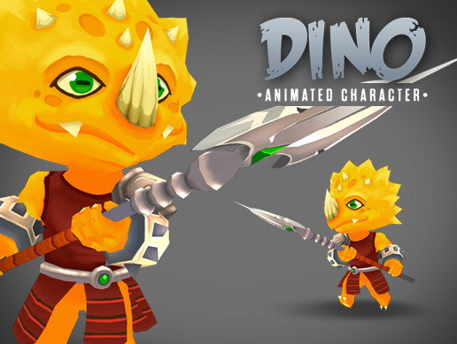
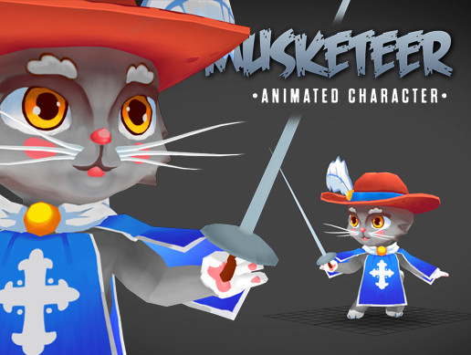
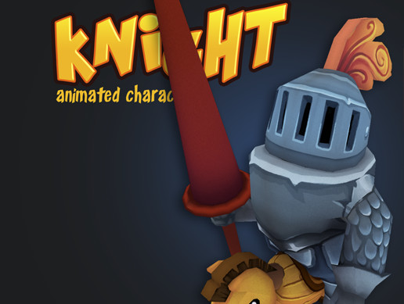
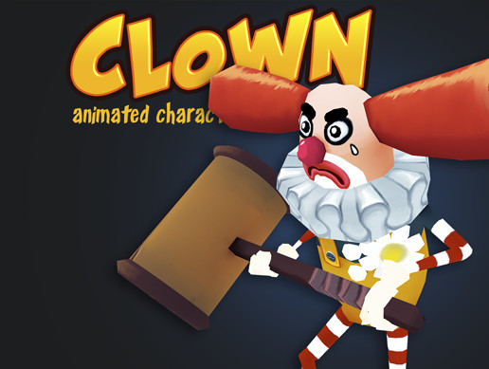
$4.99
$4.99
$4.99
$4.99
총합 $42
$4.99
$4.99
$5.99
$5.99

Slide 5
근거리
중거리
원거리

Slide 6
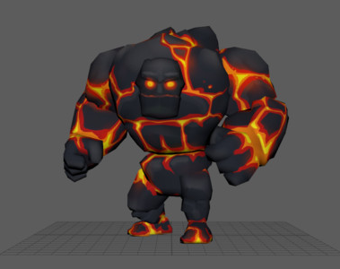
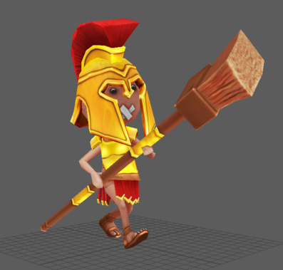
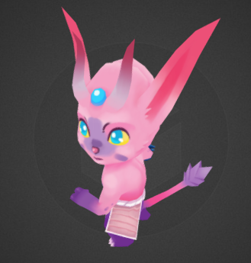
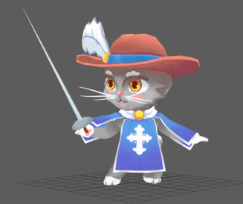
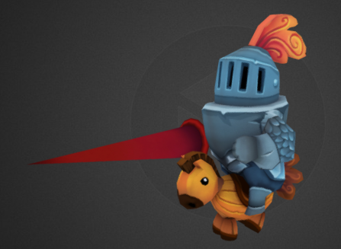
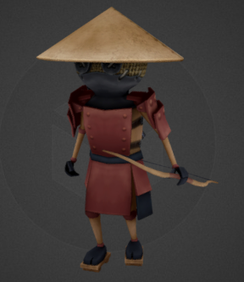
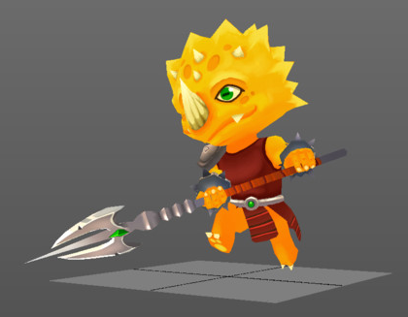

근거리
중거리
원거리

Slide 7
Golem ($4.99)
https://assetstore.unity.com/packages/3d/characters/golem-animated-chatacter-111861
Animations
- idle
- walk
- run
- attack 1
- attack 2
- hit
- stun
- jump
- death

Slide 8
Gladiator ($4.99)
https://assetstore.unity.com/packages/3d/characters/gladiator-animated-character-131256
Animations included:- appear (fall)
- atack_1
- atack_2
- atack_3
- death
- idle
- walk

Slide 9
Musketeer ($4.99)
https://assetstore.unity.com/packages/3d/characters/musketeer-animated-character-111855
Animations
- attack
- jump
- run
- idle
- stun
- damage
- death
- victory

Slide 10
Dino ($4.99)
https://assetstore.unity.com/packages/3d/dino-3d-animated-character-66356
Animations
- attack_1
- attack_2
- jump
- walk
- run
- idle
- stun
- damage
- death
- victory

Slide 11
Rogalic ($4.99)
https://assetstore.unity.com/packages/3d/rogalic-3d-animated-character-62941
Animations
- attack_1
- attack_2
- walk
- run
- idle
- stun
- damage
- death
- victory

Slide 12
Samurai ($4.99)
https://assetstore.unity.com/packages/3d/characters/samurai-animated-character-131257
Animations included:- Appear (fall)
- atack_1
- atack_2
- bow_atack_1
- bow_atack_2
- death
- idle
- walk

Slide 13
Knight ($5.99)
https://assetstore.unity.com/packages/3d/characters/knight-animated-character-79143
Animations
• falls • idle • run • attack 1 • attack 2 • attack 3 • death

Slide 14
Clown ($5.99)
https://assetstore.unity.com/packages/3d/characters/clown-animated-character-79085
Animations
• falls • idle • idle long • walk • attack 1 • attack 2 • attack 3 • death

Slide 15
2. 미니언 모델 / 애니메이션

Slide 16
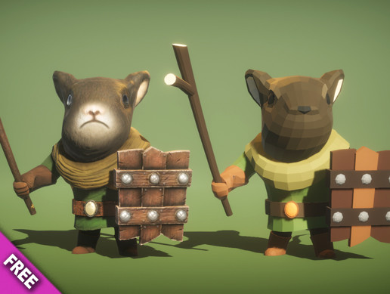
Mouse Knight (Free)
https://assetstore.unity.com/packages/3d/characters/animals/mouse-knight-pbr-polyart-135227
Animation List - Attack01 - Attack02 - Defend - Die - Die Recover - Dizzy - Get Hit - Idle - Run - Walk

Slide 17
3. 맵 모델

Slide 18
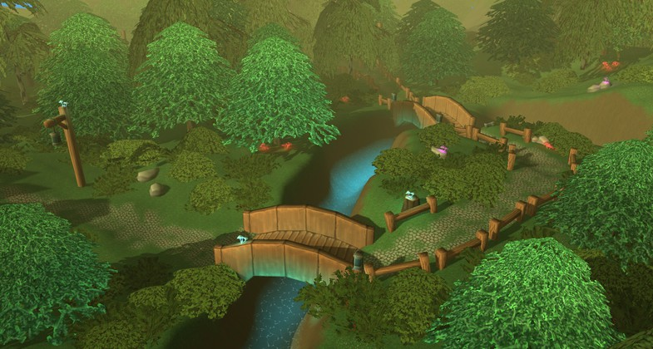
Glowing Forest (Free)
https://assetstore.unity.com/packages/3d/environments/fantasy/glowing-forest-79686

Slide 19
4. 프로토타입

Slide 20
